Slide 1
Skagit County HOME Consortium
2022 Consolidated Annual Performance & Evaluation Report (CAPER)
Lead Agency: Skagit County Public Health
Program Contacts: Madeleine Anthony
September 29, 2023

Slide 2
Consortium Overview
Composition
Island County
Whatcom County
Skagit County
17 municipalities
Consortium formed in 2015 to obtain HOME funding
Skagit County is the lead agency

Slide 3
What is the CAPER?
A component of the five-year Consolidated Plan (FY 2018-2022)
Report on accomplishments and progress toward 2022 Consolidated Plan Goals
July 2022-June 2023

Slide 4
2022 HOME Spending
$1,223,040 total HOME funds

Slide 5
2022 HOME Spending by County
$1,223,040 total HOME funds

Slide 6
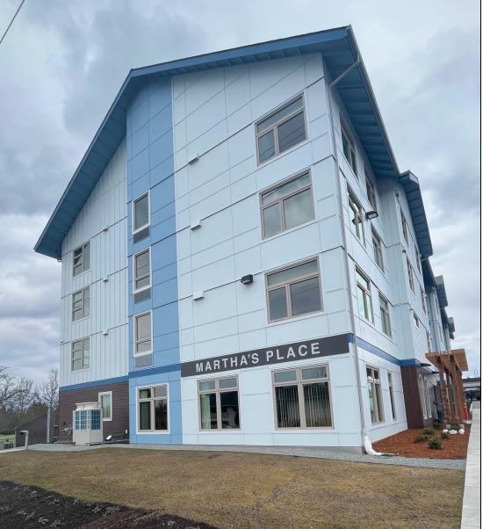
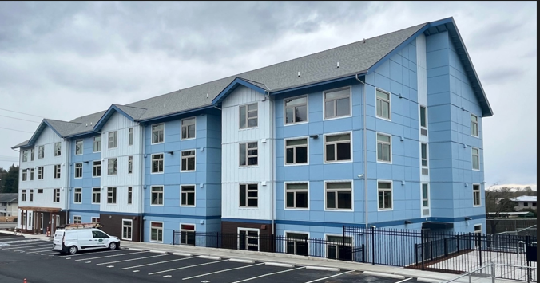
Permanent Supportive Housing Development
Construction completed in PY 2022
70 units formerly homeless, CE referred
Lease up complete in PY 2023
Notes:
70 units for formerly homeless adults and veterans referred from the local coordinated entry, 9 units specifically funded with HOME $

Slide 7
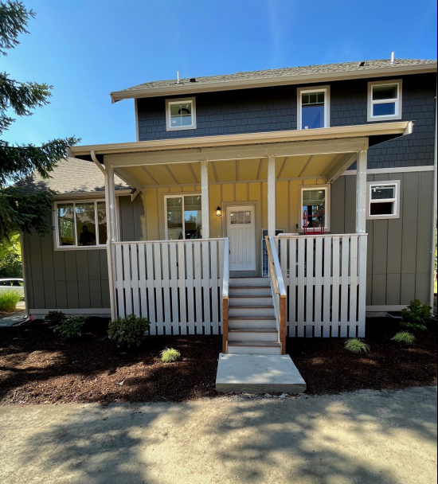
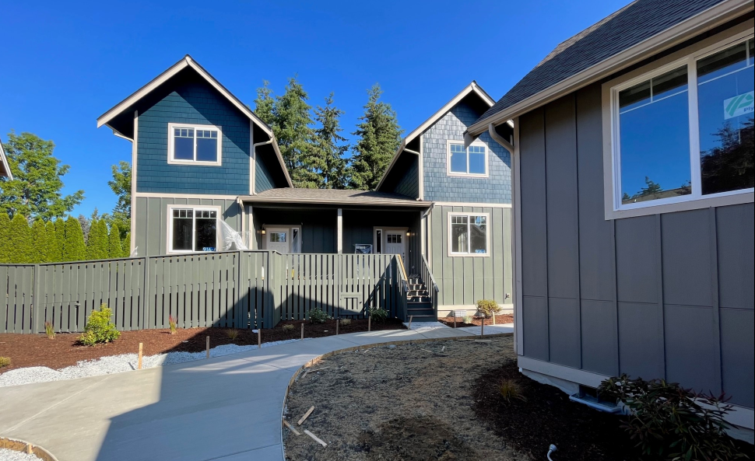
Low-income Home Ownership
5 homeownership units at Channel Cove in La Conner
First time low-income families
Homebuyer sales closed in July/August 2023
(will report on 2023 CAPER)
Notes:
Not included in the 2022 CAPER but will be in 2023 CAPER, still wanted to provide an updated on the progress made in 2022- construction completed! Certificate of occupancy issued 7/14 so will be reported as complete on 2023 caper

Slide 8
Tenant Based Rental Assistance
$292,674 total spend in PY 2022
32 households enrolled
Notes:
Households or Individuals experiencing homelessness, referred from local coordinated entry, typically up to 2 years rental assistance
Extremely Low-Income Households (30% AMI) 32 households
Low-Income Households (50% AMI) 1 household

Slide 9
Admin & CHDO Ops $149,525
Community Housing Development Organizations (CHDOs) are eligible for staffing and organizational support funds under HOME
CHDO Operations supported Home Trust of Skagit and Opportunity Council
Administrative costs

Slide 10
2022 Challenges
TBRA
Extremely low vacancy rates
Increasing rent prices
Increasingly competitive rental market
Subrecipient agencies struggled with staffing gaps
Development project delays

Slide 11
Future Activities
HOME Development NOFA
$1.6m General Development
$310,320 CHDO Development
Priority applications due December 13, 2023
HOME ARP
Island County Rental Housing: $701,157
Skagit County Rental Housing: $1,541,906
Whatcom County: $1,051,716, tbd on timing
Notes:
HOME Development NOFA is currently accepting applications, materials posted on the Skagit County Housing webpage. priority applications due 12/13.
HOME ARP NOFA opening soon as well for additional development or acquisition of affordable rental housing for specific qualifying populations (example, homeless and low income)

Slide 12
Program Contact
Public comment period on CAPER closes at 4:30 p.m. on September 29, 2023
Madeleine Anthony
Skagit County Public Health
manthony@co.skagit.wa.us
(360) 416-2018
700 S 2nd Street, Room 301
Mount Vernon, WA 98273
Notes:
We are accepting comments and questions on this report until Friday September 29th 4:30 pm.

